Slide 1
MAKING GROUND
@KatsuGames
KatsuEntertainment
KatsuEntertainment
www.katsugames.com
Stephane Imbert (co-founder)
Endless ground generation in Warhammer: DOOMWHEEL
Notes:
These slides were presented at the East Coast Game Conference on April 18th 2018.

Slide 2
About KATSU ENTERTAINMENT
Stephane Imbert
Anthony Marinello
@KatsuGames
KatsuEntertainment
KatsuEntertainment
www.katsugames.com
Notes:
KATSU Entertainment is a 2-man studio in Cary, North Carolina.
We’ve worked together for over 16 years, first at EA then as Katsu.
During that time we made many games and worked with some of the biggest names and licenses in gaming.

Slide 3
About Warhammer: DOOMWHEEL
Endless roller
iOS / Android
4.6 review
Officially licensed
Notes:
Warhammer: DOOMWHEEL is our latest game.
It’s an endless roller for mobile platforms (iOS/Android)
The game is well reviewed, sitting at a 4.6* on iOS.
It absolutely is an officially licensed Games Workshop game. When we say Warhammer, we mean Warhammer ☺
The game won the Indie Prize at the East Coast Game Conference in 2017.
It was finalist and best mobile game nominee at Casual Connect USA two years in a row.
The game was part of the official Indie Showcase selection at PAX East 2018.

Slide 4
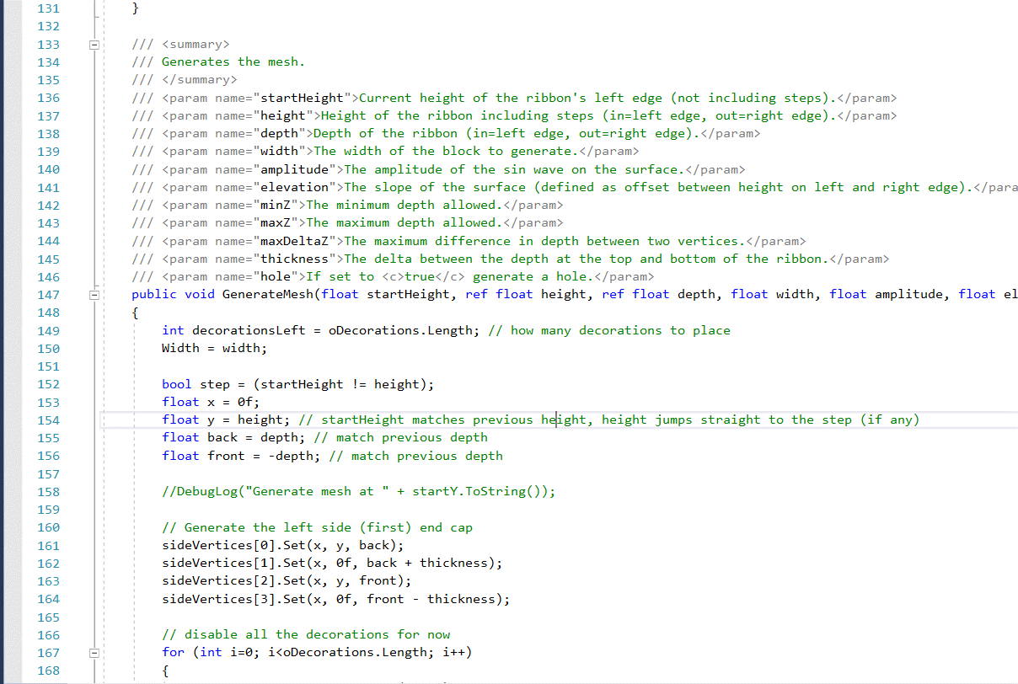
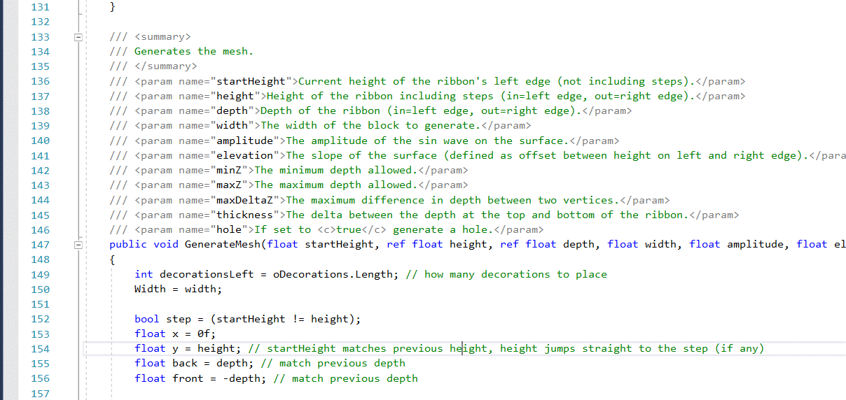
Generated Levels ( )
Notes:
This presentation is about how we generated the endless levels for the game.
The game was made using Unity and C# but the principles we discuss can easily be adapted to other game engines.

Slide 5
Endless Ground
Block prefab (box)
Object “pool”
Generated blocks or preset
Recycle blocks to avoid Unity GC
2D gameplay, 3D assets
// pseudo code
int numBlocks = block.Length;
if (camera > nextBlockX)
{
block[first].x += numBlocks * blockWidth;
first++;
if (first >= numBlocks)
{
first = 0;
nextBlockX += blockWidth;
}
}
Notes:
We started by creating an endless flat ground we called a “ribbon”.
We used a prefab to represent a flat piece of ground (a 3D cube at first)
We created an array (or pool) of these prefabs to reuse at runtime (and avoid the Unity garbage collection for performance reasons)
To generate the endless ground, we spawn enough blocks to cover the width of the screen and recycle the blocks that go off screen on the left by moving them to the end of the ribbon on the right.
This gives us a never ending ribbon of flat ground pieces for the player to roll onto.

Slide 6
Peaks And Valleys
Elevation (linear) + Amplitude (curve)
// Generate the segments for the ribbon
for (int i=0; i<=NumberOfSegments; i++) // N segments = N+1 edges
{
float percent = (float)i / (float)NumberOfSegments; // how far along are we (0.0-1.0)
x = Width * percent; // calculate the x coordinate
// calculate the curve along the cos wave
// (cos, not sin, so we start at the top of the wave instead of zero)
float curve = Mathf.Cos(percent * 2f * Mathf.PI) * amplitude - amplitude;
// add the linear elevation
y = height + curve + (elevation * percent);
}
Notes:
Once we have the flat ground, we add peaks and valleys to make the ribbon more interesting from a gameplay and visual standpoint.
To do that we replaced our box prefab with a mesh generated at runtime.
The peaks and valleys are generated by combining a linear elevation with a cosine curve.
The segments are of equal width (x), all start at y=0 and the top of the ribbon is calculated with a simple formula.

Slide 7
Cosine vs. Sine
Sine
Cosine
Notes:
We use cosine instead of sine because we place enemies on the edges of the blocks and it looks better if we do so on parts of the curve where the ground is more flat. We could also have shifted the sine to get the same result but using the cosine was easier.

Slide 8
Endless Peaks And Valleys
Keep last Y when placing/generating block geo
Add new block at random (generated or preset)
Enforce min/max for camera purposes
Too high
Camera max.
lastY
startY
lastY
lastY
startY
lastY
startY
startY
Camera min.
Notes:
To make sure the ribbon is seamless we keep track of the last Y we generated and use it as the first value for the next block.
We also need to enforce a minimum and maximum Y value to prevent the camera from going too high or too low and showing parts of the game that we don’t want the player to see (such as looking below the ground plane)

Slide 9
Low Point Examples
Notes:
The main trick here is figuring out the low point of the curve+elevation combo as the lowest point will be at different positions along the curve depending on the relative elevation and amplitude used to generate this block.

Slide 10
Enforce Camera Bounds
// keep the ribbon within the bounds
// estimate the high and low points
// Note: the amplitude is only ever subtracted from Y
// Y _ _ _ _ _ _ _ _ _ _ _
// \ / \ /
// \___/ \___/ <=== Y-2*amplitude
// the high point is at current + elevation if elevation is >0
//
// Y _____________________ ----- Y + elevation>0
// ----- | ----- |
// ----- | OR ----- |
// ----- Y + elevation<0 Y __________________|_____
float high = currentY + Mathf.Max(elevation, 0f);
// we can only go too high because of elevation
// this is because the cos wave starts at peak and only goes down
if (high > maxY)
{
elevation = ElevationMin;
}
// if elevation alone takes us below min, invert the elevation
if (currentY + elevation < minY)
{
elevation = ElevationMax;
}
// the ifs above assume that [minY,maxY] > [elevationMin,elevationMax]
// we calculate the lowest point
float low = currentY;
for (int i=0; i<_numberOfSegments; i++)
{
float percent = (float)i / (float)(_numberOfSegments);
// calculate the curve along the cos wave (see GenerateMesh)
float curve = Mathf.Cos(percent * 2f * Mathf.PI) * amplitude - amplitude;
float vertY = currentY + curve + percent * elevation;
low = Mathf.Min(low, vertY);
}
// low point is below min because of amplitude or amplitude+elevation
// check if we can keep the amplitude since curved is better than flat
if (low < minY)
{
if (currentY - amplitude < minY)
{
// amplitude alone take us below min, so flatten and go up
amplitude = 0f;
elevation = ElevationMax;
}
else
{
// amplitude alone is fine, kill only elevation
elevation = 0f;
}
}
Notes:
To enforce the maximum Y, we check the high point.
Because we subtract the amplitude from the cosine when we generate the vertices, we know only the elevation can affect the high point.
If the elevation is positive, the high point will be at currentY+elevation, otherwise it will be a currentY.
To enforce the minimum Y, we calculate all the points along the path and keep the lowest one since we can’t predict which of the vertices will be the lowest.
One additional piece of logic there is we favor keeping the curve if we can, over keeping the elevation. This is because a curved ground is more fun and interesting from a player standpoint than a flat ramp.
If we detect we will overshoot either bound, we simply reverse the elevation to make sure the ground starts changing in the right direction again.

Slide 11
Holes and Walls
Add instant death obstacles
Walls
Step last Y up
Stepping down isn’t fun
Holes
Zero out block height
Verts = Y-0-0-…-0-0-Y
Still need some geometry for collisions and visuals
STEP
Y = lastY + step;
Y = lastY;
Y = lastY;
HOLE
Y = 0;
Notes:
Now we have an endless ribbon of peaks and valleys but the game isn’t particularly challenging as the player can never die (yet)
So now is a good time to add some obstacles for the player to avoid.
The two simplest obstacles are walls and holes.
Walls are generated simply by incrementing the last Y position when we generate the new piece of ground, essentially creating a wall for the player to jump over or smash into.
Holes are similar except we zero out the height of all the vertices on the block. We keep the first and last one to the last Y position to make the hole look and feel a bit more organic and provide collision volumes for gameplay purposes.

Slide 12
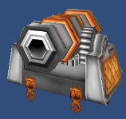
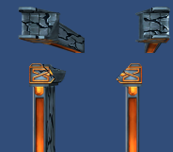
Spawn Enemies
Spawn enemies on block edge
% chance of spawning for variance
Spawned objects can:
Specify spawn position (0-100%)
Repeat N times
Require flat ground
Require hole
Enforce distance before/after
Spawn earlier to make room for crew
Notes:
Now that we have a ribbon that we can play on, we need to start adding enemies to smash.
Enemies are spawned at the edge of each block (we add a small variance so it’s not 100% predictable and we get a bit more variety)
Enemies are not spawned exactly at the edge to prevent cases where the enemy would fall down a hole for instance if that is the next block we generate.
Each enemy can specify where along the block it needs to spawn (expressed as a %)
Each enemy can also specify additional parameters such as how many times it needs to repeat, how much distance it needs in front, or behind it.
Each enemy can also overwrite whatever parameters the ground requires to create specific cases. For instance a bridge can require the block to become a hole, or flamethrowers can require the block to become flat ground.
We choose the enemy *before* we generate the mesh for this very reason.

Slide 13
Ground
Enemies need to be on the ground
Spawn well above ground
Raycast to ground
Need to raycast for gameplay anyway
Bounce / enemy rebound
Notes:
To spawn enemies, we need to know their Y coordinate.
We could go back to the formula we used to generate the ground geometry but since we need to be able to determine that point at runtime when the enemy is being thrown into the air and landing on the ground, we use a raycast instead.
The raycast allows us to always find the height of the ribbon at any X coordinate (not just the ones where a vertex is positioned)

Slide 14
Enemies Raycast
int layerMask = LayerMask.GetMask("Ground", "EnemyPlatform");
// special case: flyers and cavalry only care about the ground, not enemy platforms
if ((_flyer != null) || (_cavalry != null)) layerMask = LayerMask.GetMask("Ground");
// special case: multi-hit (or dead) enemies cannot raycast back to a platform
if (_curHP < HP) layerMask = LayerMask.GetMask("Ground");
// start raycasting well above ground, use a value large enough so we always start outside any potential collider
// because a raycast will not hit if the origin of the ray is inside the collider
// if that does not work, move the origin higher up
const float offset = 20f;
RaycastHit hitInfo;
bool hit = Physics.Raycast (transform.position + Vector3.up * offset, Vector3.down, out hitInfo, offset * 2f, layerMask);
if (hit)
{
// raycast the enemy to the ground
Vector3 pos = this.transform.parent.transform.position;
pos.y = _hitInfo.point.y;
this.transform.parent.transform.position = pos;
_shadow.SetActive (true);
_raycastHitPoint = _hitInfo.point + (_hitInfo.normal * 0.01f);
_shadow.transform.position = _raycastHitPoint;
// set the rotation so the shadow is perpendicular to the ground
// by default the quad is billboarded and facing away from the camera
// we need to rotate so it lays on the ground
// the forward vector ends up pointing down
// and the up vector is pointing away from the camera
if (transform.parent.transform.localScale.z < 0f) _shadow.transform.rotation = Quaternion.LookRotation (_hitInfo.normal, Vector3.back);
else _shadow.transform.rotation = Quaternion.LookRotation (-_hitInfo.normal, Vector3.forward);
}
else
_shadow.SetActive (false);
Notes:
This raycast uses the Unity physics API but can be easily adapted for any other game engine.
Note that depending on the type or behavior of the enemy, we raycast to a different group of objects. This is to prevent, for instance, cavalry to jump from the ground to an elevated platform.
The value 20 is an arbitrary value that we know is larger than our worst case scenario when generating the ground.
We then raycast down and if we find a hit, this is where the enemy needs to be placed.

Slide 15
Difficulty Progression
Weighted entity library
Who shows up most?
Regions (range + overlap)
Pacing and tutorial
Notes:
One of the challenges of dynamically generating levels is you have less control over difficulty progression as you can’t hand-craft and fine tune the experience.
We still needed some way to make the game easier early in the level and more difficult over time (beyond making the game faster)
We do this by:
1) Adding weights to the enemies so certain types of enemies (easy ones) will show up more often than others (more difficult ones)
2) Specify ranges (in terms of min/max distance played) and the types of enemies that are allowed for this specific range. This allows us to make sure we spawn easy enemies early on and add more difficult enemies as the player reaches higher and higher distances in the game.
Note that we allow a bit of overlap to make the results less predictable and “hide” some of the level generation from the player.

Slide 16
Choose Region
// on Awake()
// parse all the actors to figure out which ones we can use on the ribbon
// calculate weights along the way (we don't care about over-allocating for this array)
_weightSums = new float[oActorLists.Length];
for (int i=0; i<_weightSums.Length; i++)
{
_weightSums[i] = 0f;
for (int actor = 0; actor < oActorLists [i].Actors.Length; actor++)
{
_weightSums [i] += oActorLists [i].Actors [actor].GetComponent<Spawnable> ().Weight;
}
}
// do not spawn enemies every time (EnemyChance)
// but make sure to respect multiple enemies spawned back-to-back
if ((rand < EnemyChance) || (_remainingSpawns > 0))
{
if (_remainingSpawns <= 0) // new actor
{ {
// find the actor lists (max 2) that cover our current distance
int minList = -1;
int maxList = -1;
float current = Player.GetInstance ().transform.position.x;
for (int i = 0; i < oActorLists.Length; i++)
{
if (current >= oActorLists [i].Range.x)
{
if ((current <= oActorLists[i].Range.y) || (oActorLists[i].Range.y < 0f))
{
if (minList == -1)
{
minList = i;
maxList = i;
}
else
{
maxList = i;
}
...
// default to the first list found or pick one list at random if we have more than one
if (minList != maxList)
{
// sanity checking
Debug.Assert ((maxList - minList) <= 1, "Valid actor lists should be consecutive!");
float range = oActorLists [minList].Range.y - oActorLists [maxList].Range.x;
float t = (current - oActorLists [maxList].Range.x) / range;
if (Random.value > t)
{
_lastSpawnedList = maxList;
}
}
// we need a random value between 0 and the sum of all the weights in the array
float weight = Random.Range (0f, _weightSums[_lastSpawnedList]);
// we then parse the array of actors until we have summed up enough weights to match the value
// giving us the actor we need to spawn
for (int index = 0; index < oActorLists [_lastSpawnedList].Actors.Length; index++)
{
GameObject go = oActorLists [_lastSpawnedList].Actors [index];
if (go != null)
{
Spawnable gos = go.GetComponent<Spawnable>();
if (gos != null)
{
weight -= gos.Weight;
if (weight <= 0f)
{
_lastSpawnedActor = index;
break;
}
}
}
}
Notes:
Two parts.
First, because enemies can have different weights we calculate the sum of the all the weights for each region. This only needs to be done once.
Second, if we need to pick a new enemy we check our distance along the ribbon to find the regions that we need to pick enemies from.
Note that we allow up to two different regions. This allows us to create some overlap between two consecutive regions to hide the generation logic from the player. This also allows us to choose between two different regions once we run out of pre-defined regions so the game doesn’t get too repetitive or predictable.
Once we have identified which region we want to use, we roll the dice, then parse our list if enemies until we have accumulated enough weight to beat the dice roll. This tells us which enemy to spawn.
Note that “enemy” in this context means either “enemies” or “obstacles”.

Slide 17
STOP!
Now is a good time to playtest
Lock down speed
Lock down jump height
Define jump distance
Define level pacing
Notes:
At this point, we have enough code to play the game.
Now is a good time to stop and define two very important parameters:
How fast is the player traveling? This means the lowest speed when the game starts and highest when the player reaches a given distance, as we don’t want to increase speed forever and become unplayable.
How high can the player jump and double-jump.
We need to nail down these values now before we create a whole bunch of levels because the two parameters combined tell us how big or high objects need to be. For instance, the length of a hole so the player must jump to clear it, the height of a wall so the player can clear it with a single or double-jump, the height of platforms and fliers so the player can still reach them, etc.
This is important to do now as we don’t want to keep chasing our tail making a level, changing the value and reworking the level.

Slide 18
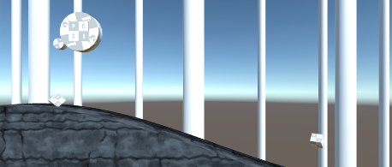
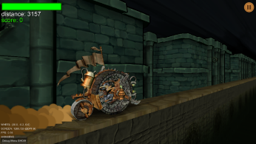
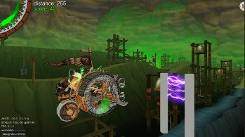
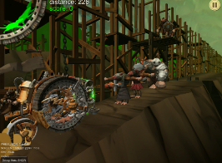
Quick Prototyping
First prototype using cylinder and cube primitives
Use asset store assets to quickly block level
Stretch and squash models to get the right “feel”
Allowed us to quickly test a new camera angle
Prototype obstacles with primitives
2D billboards as enemy placeholders
T-pose 3D models before anims
Notes:
The great thing about generating levels is you can get to playable very quickly.
Our first playable was literally a couple of cylinders for the player and cubes for the enemy. The ground generation was what made the entire gameplay work and we were able to figure out scale and speed without spending any time or money on assets (yet)
After that we used the asset store to quickly block what each level should feel like. At this point we didn’t care about how things looked so we stretched, squashed and modified models all the time. The intent was to figure out the feel of the game and the dimensions we needed before creating assets. What was great about this approach is it allowed us to discover something in our original design that wasn’t working as well as it should and address it (see next slide)
We used the same approach for creating obstacles and enemies. In order to test new gameplay we didn’t need to wait for the 3D model to be created and available. We used primitives to figure out the size of the object and its configuration before we spent money on the asset. Same with enemies, we started with 2D billboards which only required an image of the enemy and already allowed us to figure out what color and scale to use for the character to read well in the game. Even when we were getting the 3D models we did not wait for them to be 100% finished before testing them in game. If there was no animation we would just use the T-pose.

Slide 19
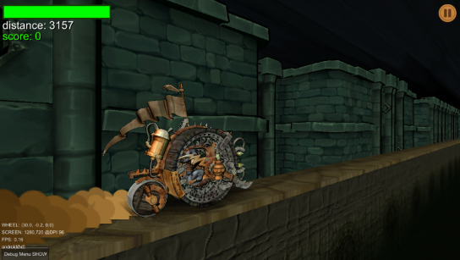
Discovery
2D
We want FAST
Faster than competition
Sense of danger
➔ More look-ahead
Rotate camera angle
See further down
Better sense of speed
Better angle for wheel model
3D
Notes:
Very early on we knew we wanted the game to feel really fast. The DOOMWHEEL is an incredibly fast war machine and the pilot is barely in control at the best of times. In order for the game to be very fast and still playable we needed to give the player plenty of look ahead to be able to react to what was coming.
With our original 2D camera, there simply wasn’t enough time to react to an obstacle or enemy appearing at the edge of the screen.
Fortunately we had made the decision early on to use 3D assets despite having 2D gameplay.
Our early playable allowed us to play with the camera and found a better camera angle that allowed us to see further down the ribbon and give players the look-ahead they needed for the game to be the speed we wanted. This also got us a better sense of speed as objects were now coming towards the player instead of on a plane perpendicular to the player and made our DOOMWHEEL model more interesting to look at, which were nice bonuses.
And all this was done before we had to commit to any art assets, which could have caused a lot of reworks and waste time and money.

Slide 20
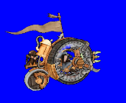
New challenge = Filling up the space
Notes:
The new camera angle did however introduce a new challenge: we were now able to see parts of our level that weren’t visible before.
We could see in between the parallax layers and through the ground.
We needed to add new geometry to fill the space and block the view so our level still felt like a living, breathing world, not a piece of code.

Slide 21
Other Challenge = Runtime Only
Notes:
Another challenge with the generated level is that there is nothing to see inside the editor.
All you get is the parameters for the generator, you need to actually run the game to see the geometry and the entities.

Slide 22
Re-Use Ribbon Generator
Far back
Ribbon far
Medium back
Ribbon medium
Ground
Medium back
Ribbon
Notes:
Fortunately for us, we just created a flexible generator that can create an endless ribbon of either generated ground or preset entities.
The way we fill the space in our level is by duplicating the ribbon to create the different layers of parallax.
We duplicate the ribbon generation to create two or more layers of rolling hills in the background.
We reuse the same generator but using preset models to populate the world with statues, columns, walls, etc. Since the generator only cares about choosing from a library of prefabs, it doesn’t really care if the prefab is a generated mesh or a preset.
The ground is also the same generator with a black polygon strip repeated endlessly.

Slide 23
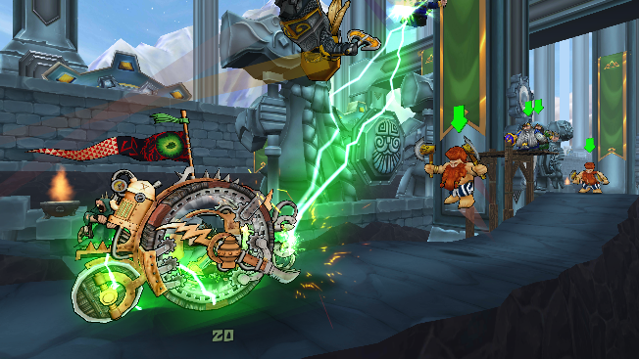
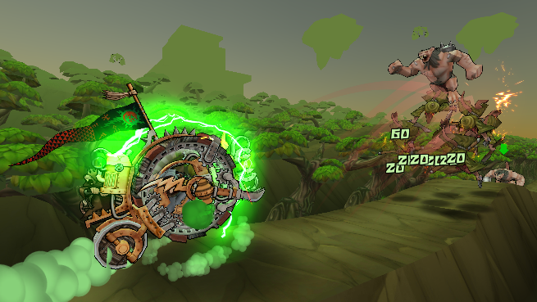
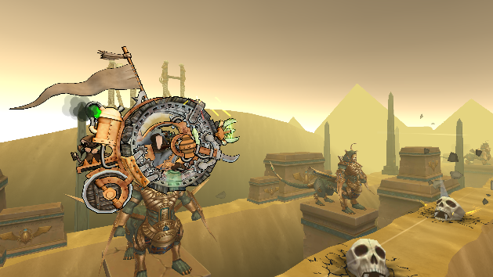
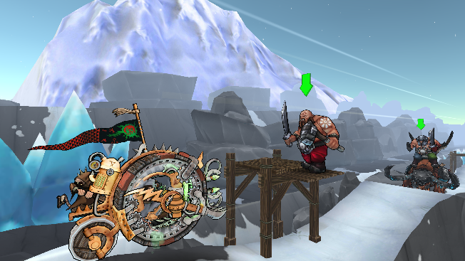
Notes:
This system allows us to create very different looking environments very easily.
See if you can spot the different layers in the GIFs above.

Slide 24
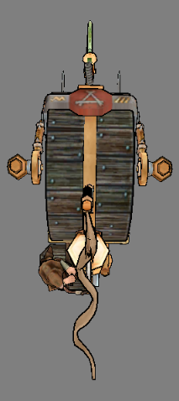
Jagged Groundz
Create more natural look
Vertex color to emulate lighting
Game is unlit
Darken based on depth
Lighter “player path”
Challenge to place tall objects on the side
Solution: make very tall objects
Notes:
Changing the angle of the camera also meant we needed to spend a little more effort on the ground itself as we needed more than just the profile of the ground seen from the 2D view. We now were able to see the top of the ribbon and its depth.
Following the same philosophy we reused what we already learned to solve the problem. The edges and depth of the ribbon were made to look more organic by applying the same elevation+curve combination we use on the height of the ribbon.
A couple of neat tricks we applied as well:
By making the ribbon wider we didn’t want to confuse players and have them think the wheel could move from side to side or that they were safe from an upcoming obstacle because their trajectory wasn’t clear. We highlighted the path the player is following in the texture so the ribbon can be as wide as it needs to be and the player still has a clear idea of where gameplay is happening.
By adding objecst to the sides of the ribbon we made the level richer visually but we needed to make sure objects were at the right height and weren’t floating in the air. To solve that problem we made sure all side objects were tall enough that no matter how high they were spawned they would always extend down to the ground (or below ground).

Slide 25
Texture Trickery
Large texture + generated UV
Reduce repetition
Horizontal & Vertical
Set UVs when generating mesh
Cheaper than vertex shader
Darken ground
Use vertex color (multiply) or…
… use fragment shader
Use Shader if geo moves or…
… to fade to other color
Notes:
One of the main visual challenges with generated environments is hiding the programmatic nature of the environment so the player doesn’t notice its artificial nature and it still feels natural.
We used a couple of texturing tricks to help:
We use a larger texture for the ground and only map a small piece of the texture to the geometry so the texture tiles over more than one piece of ground. This allows us to separate where the geometry tiles from where the texture tile and not have two indicators for the player to identify where the block starts and ends. This can be done in shader or when the geometry is generated.
We also used the vertex and fragment shaders to fade the ground to black at ground level. We did this in shader because we needed to handle moving objects such as bridges that collapse as the player rides over them.

Slide 26
World Fog vs Camera Fog
World based fog
USED for atmospherics effect and increase the sense of depth for the environment.
Camera based fog
USED to hide objects spawning ahead of the player.
Notes:
One last trick we used when rendering was supplementing the built-in Unity fog with a custom fog.
The default Unity fog, which is camera based, works great for hiding objects popping in the distance.
Because of our camera angle, objects that are technically closer to the camera but further back in Z from the player feel like they should get lost in the ambient fog as well. We implemented our own fog based on the depth of the object to add subtle atmospheric effects to the world behind the player.

Slide 27
Shader Code (Props/Ground)
v2f vert (appdata v) {
v2f o;
// get vertex coordinates in SCREEN space
o.vertex = UnityObjectToClipPos(v.vertex);
// get vertex coordinates in WORLD space
float4 world = mul(unity_ObjectToWorld, v.vertex);
o.uv = v.texcoord; // save Uvs (meshes)
o.uv = world.xy * _Scale; // scale Uvs (ground)
o.diff = v.color; // vertex color
// fog and fade
UNITY_TRANSFER_FOG(o,o.vertex); // default fog (camera depth)
float depth = clamp(world.z*_FogDist, 0.0, 1.0); // world fog
o.other.y = depth; // store depth (for fog)
float height = clamp(world.y * 0.2, 0.0, 1.0); // height fade
o.other.x = height; // store height (moving geo only)
return o;
}
fixed4 frag (v2f i) : SV_Target {
// sample ground texture
fixed4 col = tex2D(_MainTex, i.uv) * _EnvironmentColor;
// multiply by vertex color (unlit shading)
col *= i.diff;
// fade to color at bottom
col = lerp(_EnvironmentMistColor, col, i.other.x);
// add custom fog (world depth fog, not camera)
col.rgb = lerp(col.rgb, _FogColor.rgb, i.other.y);
col.a = 1;
// apply Unity fog (camera depth fog)
UNITY_APPLY_FOG(i.fogCoord, col);
return col;
}
Props
vs
Ground
Props
only
Props
only
Notes:
This is our simple shader code that adds texture scaling, custom fog and fade to black to our models.
Note that props use the Uvs from their model as they are not dynamically generated meshes. The ground however generates Uvs at runtime.
Also note that we only apply the height fade to props since they have the potential to move, unlike the ground which is a static.

Slide 28
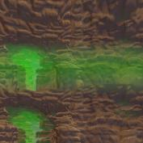
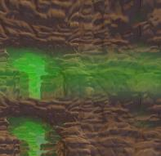
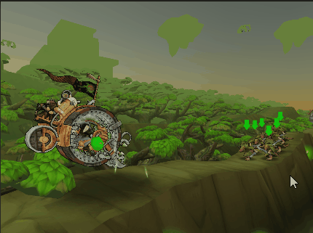
Centerpiece and Skybox
Large structure in background
Slides with camera
Rotates CW
Repeatable skybox texture
Rotates CCW
Notes:
A couple more neat tricks.
With our camera angle, about half of the screen shows sky. Having such a large piece of screen that barely moves can be problematic to getting a good sense of speed, regardless of how fast the rest of the game moves.
To add motion to the sky we used two neat tricks:
First, we rotate the skybox to create some subtle motion in the sky itself.
Second, we added a large element (called a “centerpiece“) that serves as a strong visual element in the sky, like a mountain or a large statue.
Because we move endlessly on the X axis, placing a large object in the distance would have been very difficult. We faked it by making a much smaller object that we placed at a constant offset from the camera, giving the illusion that the object is much farther than it really is. The object also rotates in the opposite direction as the skybox which gives the illusion that the player is on a wide circular path around the centerpiece instead of travelling on a straight line.

Slide 29
Spawn distance and Poppin’
Look ahead means higher spawn distance
Too late = visible popping
Too soon = performance hit
In practice, not much of an issue
Player too busy to pay attention
When noticeable, draws attention to incoming obstacles
Notes:
A note on spawn distance.
When spawning objects at runtime, the main challenge is balancing spawning objects so the player doesn’t see them popping to life on screen but they don’t spawn so early they waste cycle without being visible.
In our case, the Unity default fog hid most of the popping for enemies and ribbon pieces. The one case where popping occurs turned out to not be too much of an issue as the popping draws attention to the upcoming obstacle and this type of obstacles is the most difficult one in the game, so the popping actually works in the player’s favor (see next slide).

Slide 30
Spawning artillery
Artillery projectiles must land at specific points ahead of the wheel for gameplay reasons
Projectile target point is the spawn point
The artillery piece is spawned at an offset that places it on a ribbon in the background
Artillery
Offset
Spawn points
Notes:
Artillery pieces were the most challenging enemy to get right as they require two different pieces to work together.
The artillery projectile is what the player cares about as it creates an obstacle on the ribbon that the player must avoid.
The artillery projectile does however need some form of artillery war machine to not just be falling form the sky and the war machine needs to be spawned further out in the distance which can be tricky when your entire level is generated.
We tackled this scenario by spawning the projectile and having it spawn the war machine it needs in the background. We then just need to make sure the distance at which the war machine is spawned lines up with the position of a generated ground ribbon and raycast the artillery to the ground like all other enemies.

Slide 31
Optional behaviors
Cavalry
Destructible
Flyer
Flamethrower
Jumper
Multi-hit
Notes:
Generating levels also means generating enemy behaviors.
While spawning different enemies is one thing, but it’s not great if all enemies just stand around waiting to be smashed.
We added a flexible behavior system to our enemies to quickly create different enemies for each level.
We did this by identifying the types of behaviors that some enemies would have in common and define these behavior classes in a generic enough way that we could just tag an enemy as a “flyer” or “flamethrower” and quickly get the desired gameplay.
Note that the behaviors could also be combined so you could have a cavalry enemy that is also a flyer and also shoots flames.
The behaviors we created were:
Cavalry: an enemy that moves along the ribbon, either towards or away from the player. Note this is different from Mount (not shown on the graph) which is a behavior that allows an enemy to spawn its rider and keep it attached to it until they get hit by the player’s wheel.
Destructible: an enemy or obstacle that breaks into pieces when hit by the player’s wheel.
Flyer: an enemy that keeps a certain distance from 0 or from the ribbon.
Flamethrower: an enemy (or obstacle) that shoots flames when the player gets to a certain distance. Flames hurt the player.
Jumper: an enemy that jumps over the player to avoid collisions.
Multi-hit: an enemy that needs to be hit more than once before it dies.

Slide 32
From Concept To Game
Notes:
Finally, one word of caution if you want to create your own generated game: one hidden cost of generating your levels is that, unlike pre-crafted experiences, when it comes down to creating cool screenshots for your game or video footage, you don’t know or really control when something cool is going to be on screen. This makes creating marketing material very time consuming and that should not be under-estimated. On the plus side, you control how things get generated and it’s ok to cheat a little bit with your level generation if it makes it easier to create a specific scenario for your captures ☺

Slide 33
Questions?
KatsuEntertainment
View KatsuEntertainment
Sign up at katsugames.com
Notes:
That’s all folks ☺
If you liked this presentation, we’d appreciate if you could pass the word along so we can keep providing great content to you guys.
And if you are so inclined, you can find us on our social media, so stop by and say “hi!”

